Slide 1

ThyroSense
A Database Management Project for Healthcare Industry

Slide 2
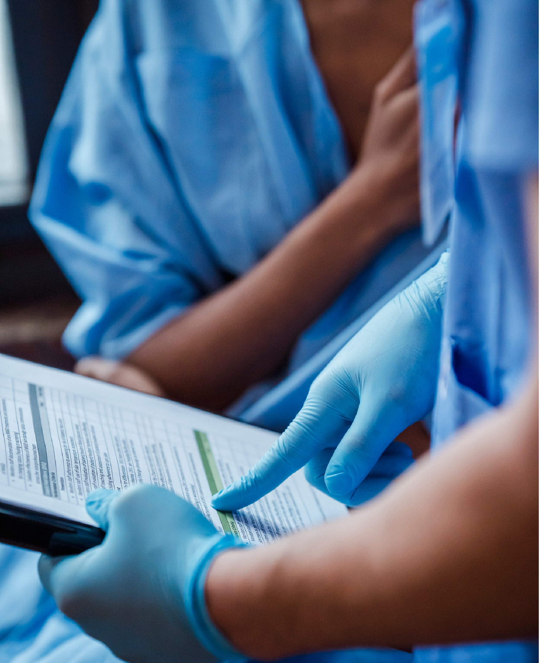
Abstract
In this project, we aim to develop a database management system for healthcare providers to predict the likelihood of an individual having goiter based on their medical history and physical examination. The system will use data analysis and machine learning techniques to create an accurate prediction model that can assist healthcare providers in making informed diagnoses and treatment plans for patients.

Slide 3

Objectives
Develop a database management system for goiter prediction.
Integrate machine learning techniques for accurate goiter prediction.
Test and validate the model with real-world medical data.
Develop a user-friendly interface for healthcare providers.
Enable timely and accurate goiter diagnosis and treatment.

Slide 4
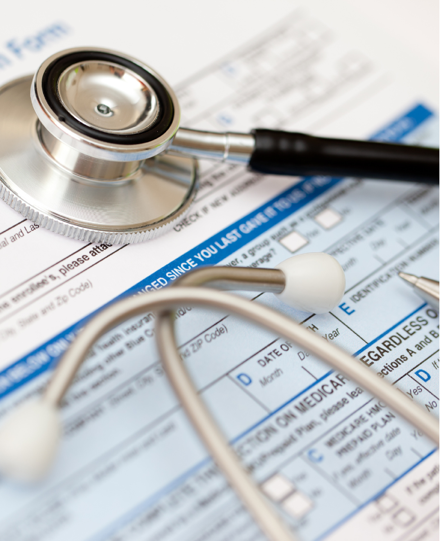




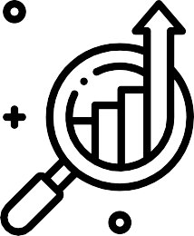


Scope
Collecting and integrating medical history and physical examination data into a database management system for analysis.
Data analysis: Using machine learning techniques to analyze the data and develop an accurate prediction model.
Developing a database management system that can efficiently store and retrieve patient data for goiter prediction.

Slide 5

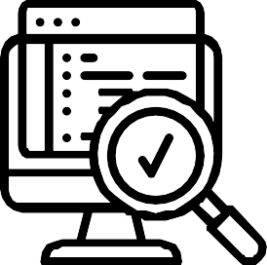
Scope
Developing a user-friendly interface that allows healthcare providers to input patient data and obtain goiter prediction results.
Testing and validating the prediction model with real-world medical data to ensure accuracy and reliability.
Deploy and maintain the system in healthcare facilities to ensure its effective use and continued improvement.

Slide 6
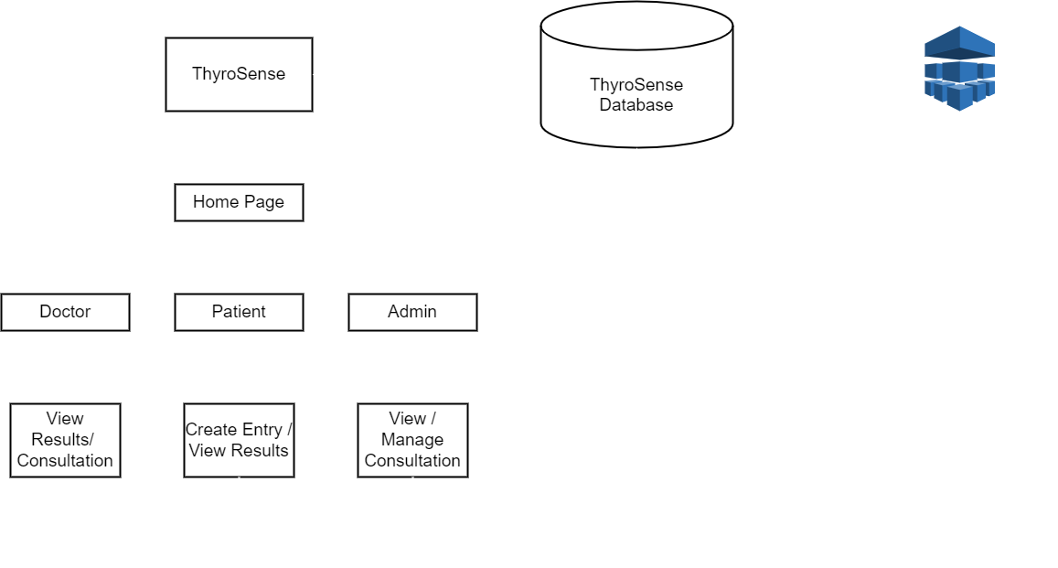
Architecture Diagram
Three-tier architecture with Admin, Patient, and Doctor users, and a database management system.

Slide 7

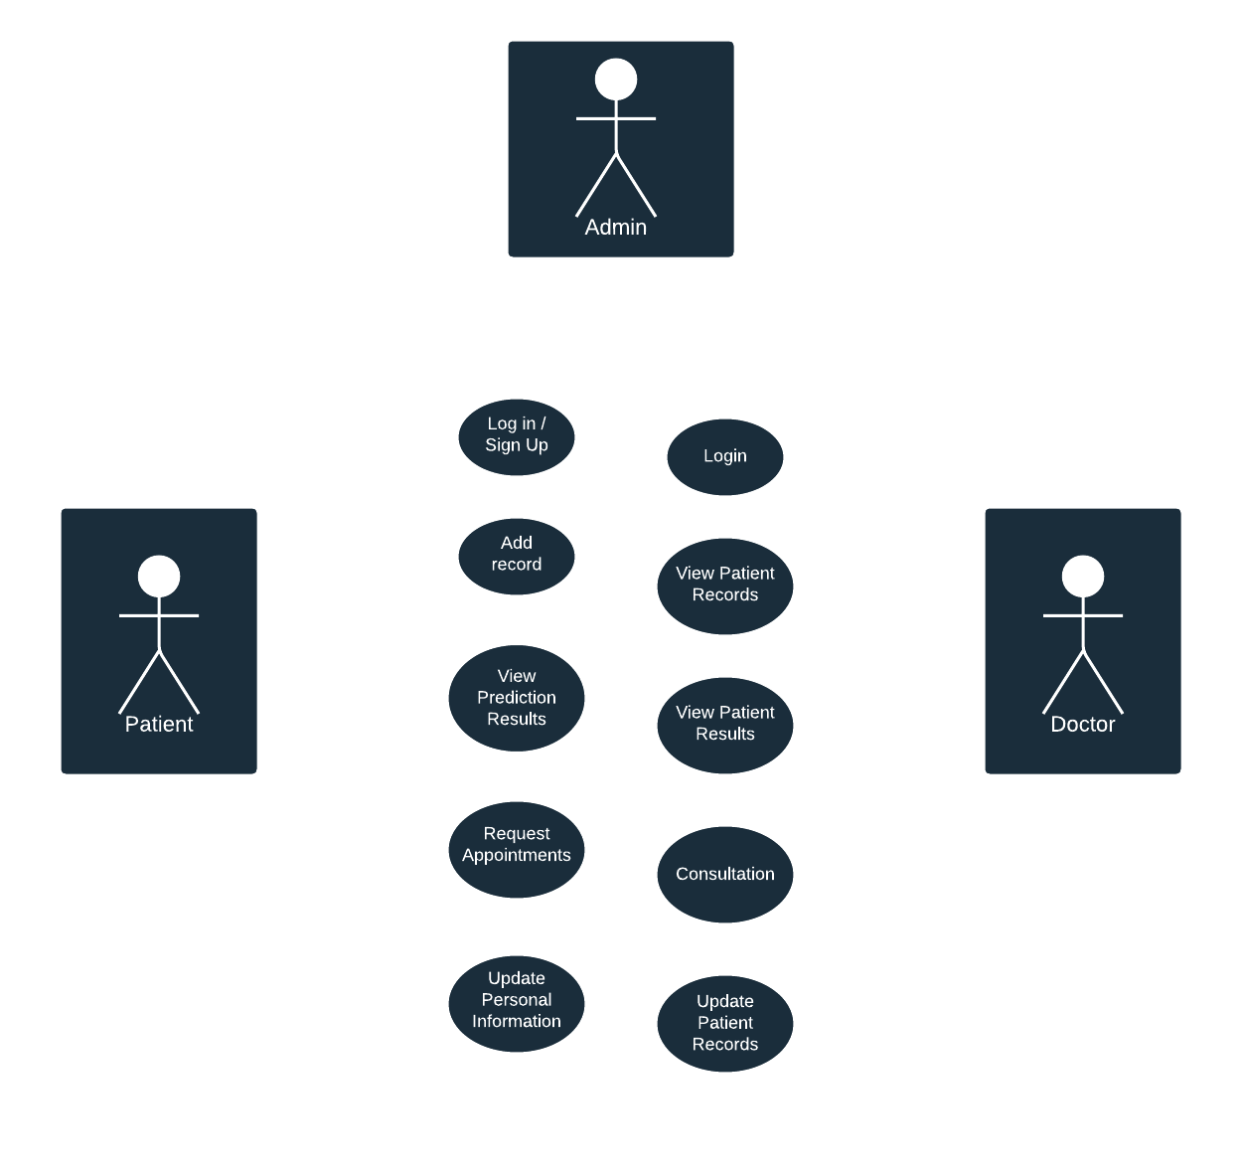
Use Case

Slide 8


References
https://www.kaggle.com/datasets/ya sserhessein/thyroid-disease-data-set https://cdas.cancer.gov/datasets/plc o/8/ https://archive.ics.uci.edu/ml/datase ts/thyroid+disease http://odds.cs.stonybrook.edu/thyroi d-disease-dataset/

Slide 9
Thank You
Team 18 - ThyroSense

